Slide 1
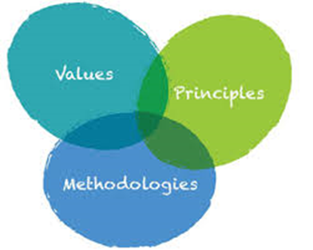

AGILE VALUES AND PRINCIPLES
By:
FTP 90

Slide 2
CONTENTS
Traditional Methodologies.
What is Agile?
Why Agile?
Values.
Principles.

Slide 3
TRADITIONAL METHODOLOGIES
Waterfall Model.
V-Shaped Model.
Evolutionary Prototyping Model.
Spiral Method.
Iterative and Incremental Method.

Slide 4
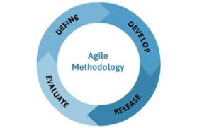
WHAT IS AGILE?
Agile is a software development methodology to build a software incrementally using short iterations of 1 to 4 weeks so that the development is aligned with the changing business needs.

Slide 5

WHY AGILE?
High product quality.
Higher customer satisfaction.
Increased project control.
Reduced risks.
Faster ROI.

Slide 6
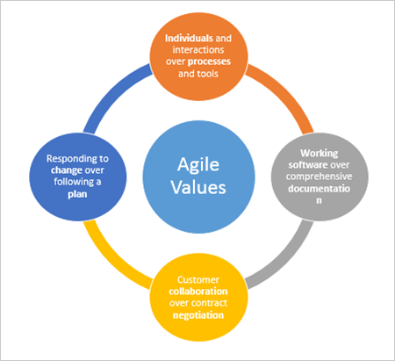
VALUES

Slide 7
VALUES
1. Individuals and Interactions Over Processes and Tools
2. Working Software Over Comprehensive Documentation
3. Customer Collaboration Over Contract Negotiation
4. Responding to Change Over Following a Plan

Slide 8
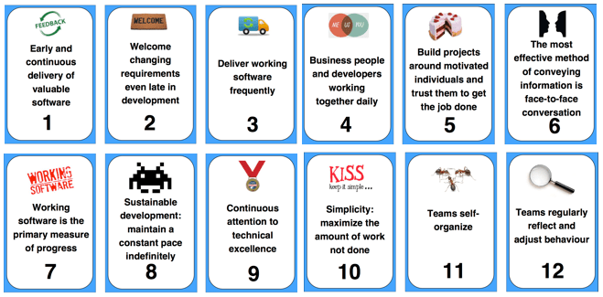
PRINCIPLES

Slide 9
PRINCIPLES
1.Customer satisfaction through early and continuous software delivery.
2. Accommodate changing requirements throughout the development process.
3. Frequent delivery of working software.
4. Collaboration between the business stakeholders and developers throughout the project.

Slide 10
PRINCIPLES contd..
5. Support, trust, and motivate the people involved.
6. Enable face-to-face interactions.
7. Working software is the primary measure of progress
8. Agile processes to support a consistent development pace

Slide 11
PRINCIPLES contd..
9. Attention to technical detail and design enhances agility.
10. Simplicity.
11. Self-organizing teams encourage great architectures, requirements, and designs.
12. Regular reflections on how to become more effective

Slide 12
CONCLUSION
Values
Practices
Principles

Slide 13


Slide 14


